Slide 1
Basic sql- part 3
Natural join to null values in aggregate function

Slide 2
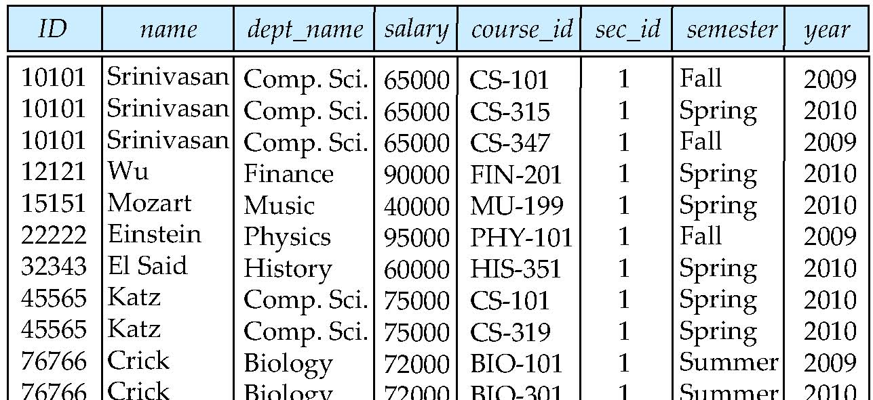
Natural Join
Natural join matches tuples with the same values for all common attributes, and retains only one copy of each common column
select *from instructor natural join teaches;

Slide 3
Natural Join Example
List the names of instructors along with the course ID of the courses that they taught.
In two ways we can write the Query:
select name, course_id from instructor, teaches where instructor.ID = teaches.ID;
OR
select name, course_id from instructor natural join teaches;
Notes:
3

Slide 4
A from clause in an SQL query can have multiple relations combined using natural join, as shown here:
select A1, A2, . . . , An
from r1 natural join r2 natural join . . . natural join rm
where P;

Slide 5
Retrieve the names of all instructors, along with their department names and department building name.
instructor(ID, name, dept_name, salary)
department(dept_name, building, budget)
Query:
Select name, dept_name , building from instructor, department where instructor.dept_name=department.dept_name
Using natural join

Slide 6
Display the computer science courses which are held in room no=105 and building AB5
course(course_id, title, dept_name, credits)
section(course_id, sec_id, semester, year, building, room_number, time_slot_id)
select course_id from course, section where course.course_id=section.course_id and building=’AB5’ and room_number=105 and dept_name=’CS’;
using natural join:

Slide 7
Natural Join (Cont.)
Danger in natural join: beware of unrelated attributes with same name which get equated incorrectly
course(course_id, title, dept_name, credits)
teaches(ID, course_id, sec_id, semester, year)
instructor(ID, name, dept_name, salary)
List the names of instructors along with the titles of courses that they teach
select name, title from instructor natural join teaches natural join course;
the natural join of instructor and teaches contains the attributes (ID, name, dept name, salary, course id, sec id, sem, year),
while the course relation contains the attributes (course id, title, dept name, credits).
As a result, the natural join of these two would require that the dept name attribute values from the two inputs be the same, in addition to requiring that the course id values be the same. This query would then omit all (instructor name, course title) pairs where the instructor
teaches a course in a department other than the instructor’s own department.
Notes:
The operation join . . . using requires a list of attribute names to be specified.
Consider the operation r1 join r2 using(A1, A2). The operation is similar to r1 natural join r2, except that a
pair of tuples t1 fromr1 and t2 fromr2 match if t1.A1 = t2.A1 and t1.A2 = t2.A2; even if r1 and r2 both have an attribute named A3, it is not required that t1.A3 = t2.A3.

Slide 8
(ID, name, dept name, salary, course id, sec id, sem, year),
(course id, title, dept name, credits).
This query would then omit all (instructor name, course title) pairs where the instructor teaches a course in a department other than the instructor’s own department

Slide 9
List the names of instructors along with the titles of courses that they teach
correct version
select name, title from (instructor natural join teaches) join course using(course_id);
The operation join . . . using requires a list of attribute names to be specified.
No other common attribute even if present will be matched, other than the ones indicated in using clause..

Slide 10
Display id of students who have taken the course offered by physics department
student(SID, name, dept_name, tot_cred)
takes(SID, course_id, sec_id, semester, year, grade)
course(course_id, title, dept_name, credits)
Select student.SID from student, course, takes where student.SID= takes.SID and course.course_id =takes.course_id and course.dept_name=”physics” ;
Select student.SID from (student natural join takes ) join course using course_id where course.dept_name=”physics”

Slide 11
Display the student’ details who scored A or A+ grade in “DBS” course.
student(SID, name, dept_name, tot_cred)
takes(SID, course_id, sec_id, semester, year, grade)
course(course_id, title, dept_name, credits)

Slide 12
Additional Basic Operations
The Rename Operation
The names of the attributes in the result are derived from the names of the attributes in the relations in the from clause.
We may need to change this for the following reasons:
two relations in the from clause may have attributes with the same name,
in which case an attribute name is duplicated in the result.
if we used an arithmetic expression in the select clause, the resultant attribute does not have a name.
even if an attribute name can be derived from the base relations as in the preceding example, we may want to change the attribute name in the result.
The SQL allows renaming relations and attributes using the as clause:
old-name as new-name
E.g.
select ID, name, salary/12 as monthly_salary from instructor
Notes:
12
9
Between T and S Join with condition T.salary > S.salary is performed then the selection operation is performed.
i.E when ever we compare two tables column that is performing join condition.
First, two relations in the from clause may have attributes with the same name,
in which case an attribute name is duplicated in the result.
Second, if we used an arithmetic expression in the select clause, the resultant attribute does not have
a name.
Third, even if an attribute name can be derived from the base relations as in the preceding example, we may want to change the attribute name in the result.

Slide 14
One reason to rename a relation is to replace a long relation name with a shortened version that is more convenient to use elsewhere in the query.
select T.name, S.course id
from instructor as T, teaches as S
where T.ID= S.ID;

Slide 15
Another reason to rename a relation is a case where we wish to compare tuples in the same relation. We then need to take the Cartesian product of a relation with itself and, without renaming, it becomes impossible to distinguish one tuple from the other.
Find the names of all instructors who have a higher salary than some instructor in ‘Comp. Sci’.
select distinct T. name from instructor as T, instructor as S where T.salary > S.salary and S.dept_name = ‘Comp. Sci.’
An identifier, such as T and S, that is used to rename a relation is referred to as a correlation name in the SQL standard, but is also commonly referred to as a table alias, or a correlation variable, or a tuple variable.
Notes:
15
9
Between T and S Join with condition T.salary > S.salary is performed then the selection operation is performed.
i.E when ever we compare two tables column that is performing join condition.
One reason to rename a relation is to replace a long relation name with a shortened version that
is more convenient to use elsewhere in the query.
Another reason to rename a relation is a case where we wish to compare tuples in the same relation. We then need to take the Cartesian product of a relation with itself and, without renaming, it becomes impossible to distinguish one tuple from the other. Suppose that we want to write the query “Find the names of all instructors whose salary is greater than at least one instructor in the Comp. Science department.”
One more example for Self referring table: Display Employee ‘s information along with their supervisor name.
Employee(id,name,manager_id)…..display employee name with names of their manager
SELECT e1.Name EmployeeName, e2.name AS ManagerName
FROM Employee e1
INNER JOIN Employee e2
ON e1.ManagerID = e2.EmployeeID

Slide 16
String Operations
Note: The SQL standard specifies that the equality operation on strings is case sensitive;
as a result the expression “’comp. sci.’ = ’Comp. Sci.’” evaluates to false.
However, some database systems, such as MySQL and SQL Server, do not distinguish
uppercase from lowercase when matching strings; as a result “’comp. sci.’= ’Comp. Sci.’” would evaluate to true on these databases. This
SQL includes a string-matching operator for comparisons on character strings. The operator “like” uses patterns that are described using two special characters:
percent (%). The % character matches any substring.
underscore (_). The _ character matches any character.
Find the names of all instructors whose name includes the substring “dar”. select name from instructor where name like '%dar%'
Notes:
16

Slide 17
Patters are case sensitive.
Pattern matching examples:
‘Intro%’ matches any string beginning with “Intro”.
‘%Comp%’ matches any string containing “Comp” as a substring.
‘_ _ _’ matches any string of exactly three characters.
‘_ _ _ %’ matches any string of at least three characters.

Slide 18
exercises
display all the records from the CUSTOMERS table, where the SALARY starts with 200.
SELECT * FROM table_name WHERE column LIKE 'X%'
SELECT * FROM table_name WHERE column LIKE '%X%'
SELECT * FROM table_name WHERE column LIKE 'X_'
SELECT * FROM table_name WHERE column LIKE '_X'
SELECT * FROM table_name WHERE column LIKE '_X_'

Slide 19
String Operations (Cont.)
Match the string “100 %” // Usage of % in a string
‘\’ is used to specify the special character such as % or \.
(eg. Retrieve whose attendance status is 100%)
Select names from student where attendance like ‘100\%’
SQL supports a variety of string operations such as
concatenation (using “||”)
converting from upper to lower case (and vice versa)
finding string length, extracting substrings, etc.
Eg.: Select SUBSTR(‘ABCDEF’, 2, 3) as substring from tablename ; o/p: BCD
select length(name) as length_val from dual ;
select upper(‘hi’) as Upper_val from dual ;
Notes:
19

Slide 20
Ordering the Display of Tuples
List in alphabetic order the names of all instructors select distinct name from instructor order by name
We may specify desc for descending order or asc for ascending order, for each attribute; ascending order is the default.
Example: order by name desc
Can sort on multiple attributes
Example: order by dept_name, name
General Form:
SELECT distinct name FROM instructor
WHERE Dept_name=‘CS’
ORDER BY name ;
Notes:
20

Slide 21
Where Clause Predicates
SQL includes a between comparison operator
Example: Find the names of all instructors with salary between $90,000 and $100,000 (that is, ≥ $90,000 and ≤ $100,000)
select name from instructor where salary between 90000 and 100000
Tuple comparison
select name, course_id from instructor, teaches where (instructor.ID, dept_name) = (teaches.ID, ’Biology’);
All SQL platforms may not support this syntax
Notes:
21
7

Slide 23
Set Operations
Find courses that ran in Fall 2009 or in Spring 2010
(select course_id from section where sem = ‘Fall’ and year = 2009) union (select course_id from section where sem = ‘Spring’ and year = 2010)
Notes:
23
Doubt: Why they have to write complicated set operation, when they can write in single where clause:
Ans: For this eg. It is not required , but for the scenario where L.H.S and R.H.S of the set operation involves different queries. Find such eg.

Slide 24
Find courses that ran in Fall 2009 and in Spring 2010
(select course_id from section where sem = ‘Fall’ and year = 2009) intersect (select course_id from section where sem = ‘Spring’ and year = 2010)

Slide 25
Find courses that ran in Fall 2009 but not in Spring 2010
(select course_id from section where sem = ‘Fall’ and year = 2009) except
(select course_id from section where sem = ‘Spring’ and year = 2010)

Slide 26
Set Operations
Set operations union, intersect, and except
Each of the above operations automatically eliminates duplicates
To retain all duplicates use the corresponding multiset versions union all, intersect all and except all.
Notes:
26
Eg: in r : a,a,b,c
in s: a,b,c
With regard to a it is : m is 2 and n is 1, 3 times a will be in result.
For intersect min(2,1) will be in result.
For intersect: 0 if it does not exist or 2-1 time in , here 1 time a will be in result.

Slide 27
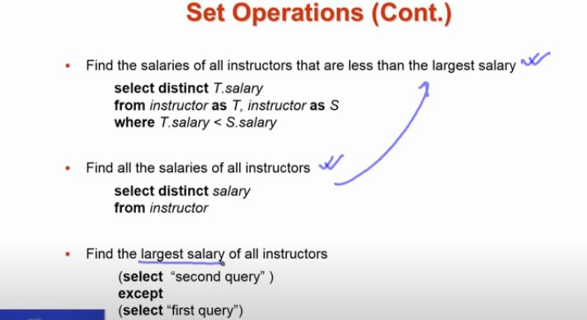

Slide 28
Null Values
It is possible for tuples to have a null value, denoted by null, for some of their attributes
null signifies an unknown value or that a value does not exist.
The result of any arithmetic expression involving null is null
Example: 5 + null returns null
The predicate is null can be used to check for null values.
Example: Find all instructors whose salary is null.
select name from instructor where salary is null;
Notes:
28
Result of Arithmetic or logical operations involving null values.
Arithmetic returns null
Logical operation returns Unknown
Ex. Giving hike to an instructor.

Slide 29
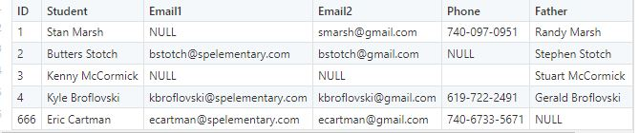
SELECT ID, Student,Email1,Email2 FROM tblSouthPark WHERE Email1 IS NULL AND Email2 IS NULL;

Slide 30
Null Values and Three Valued Logic
Any comparison with null returns unknown
Example: 5 < null or null <> null or null = null
Three-valued logic using the truth value unknown:
OR: (unknown or true) = true, (unknown or false) = unknown (unknown or unknown) = unknown
AND: (true and unknown) = unknown, (false and unknown) = false, (unknown and unknown) = unknown
NOT: (not unknown) = unknown
“P is unknown” evaluates to true if P is not know
Notes:
30
If the where clause predicate evaluates to either false or unknown for a tuple, that tuple is not added to the result

Slide 31
Aggregate Functions
Aggregate functions are functions that take a collection (a set or multiset) of values as input and return a single value. SQL offers five built-in aggregate functions:
avg: average value min: minimum value max: maximum value sum: sum of values count: number of values
Notes:
31

Slide 32
Aggregate Functions (Cont.)
Find the average salary of instructors in the Computer Science department
select avg (salary) from instructor where dept_name= ’Comp. Sci.’;
Find the total number of instructors who teach a course in the Spring 2010 semester
select count (distinct ID) [Distinct: Since same teacher teaching more than one subject in Spring 10] from teaches where semester = ’Spring’ and year = 2010
Find the number of tuples in the course relation
select count (*) from course;
Notes:
32

Slide 33
“group by” clause
There are circumstances where we would like to apply the aggregate
function not only to a single set of tuples, but also to a group of sets of
tuples; we specify this wish in SQL using the group by clause.
The attribute or attributes given in the group by clause are used to form groups.
Tuples with the same value on all attributes in the group by clause are placed in one group.

Slide 34
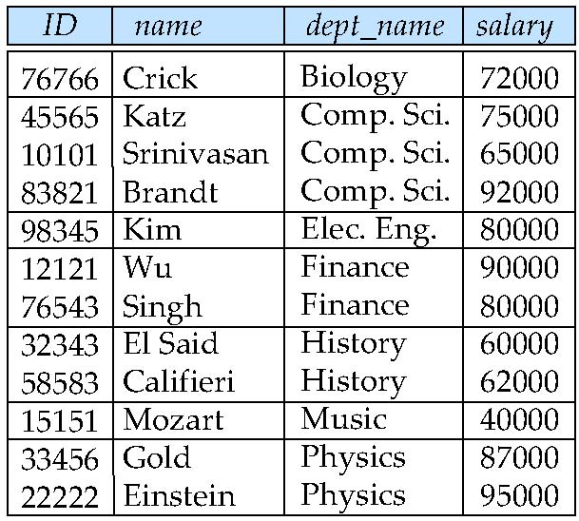
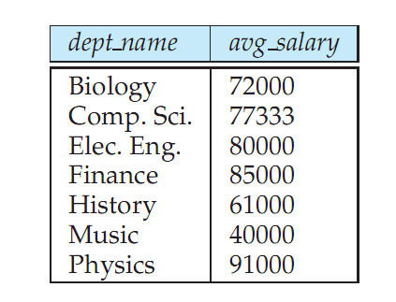
Aggregate Functions – Group By
Find the average salary of instructors in each department
select dept_name, avg (salary) from instructor group by dept_name;
Note: departments with no instructor will not appear in result
Notes:
34

Slide 35
Find the number of instructors in each department who teach a course in the Spring 2
select dept name, count (distinct ID) as instr_count
from instructor natural join teaches
where semester = ’Spring’ and year = 2010
group by dept name; 010 semester.

Slide 36
Aggregation (Cont.)
Attributes in select clause outside of aggregate functions must appear in group by list.
In other words, any attribute that is not
present in the group by clause must appear only inside an aggregate function if
it appears in the select clause, otherwise the query is treated as erroneous.
/* erroneous query */
select dept_name, ID, avg (salary) from instructor group by dept_name;
Each instructor in a particular group (defined by dept name) can have a different
ID, and since only one tuple is output for each group, there is no unique way of
choosing which ID value to output. As a result, such cases are disallowed by SQL.

Slide 37
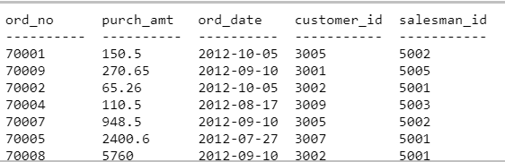
exercise
Write a SQL statement to find the total purchase amount of all orders
Select sum(purch_amt) from orders;
Write a SQL statement to find the number of salesmen currently listing for all of their customers.
Select count(distinct salesman_id) from orders;

Slide 38
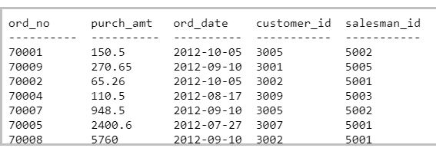
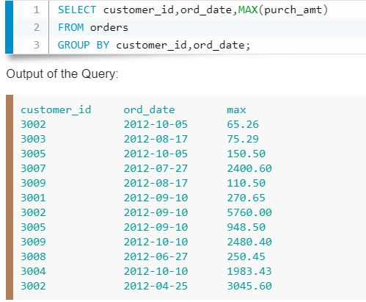

Slide 39
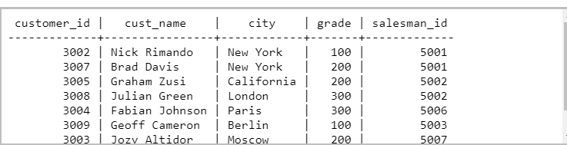
Write a SQL statement to know how many customer have listed their names.
find the number of customers who gets at least a gradation for his/her performance.
find the highest purchase amount by the each customer with their ID and highest purchase amount
SELECT customer_id, MAX(purch_amt) FROM orders GROUP BY customer_id;

Slide 40
“Group by… having “ clause
At times, it is useful to state a condition that applies to groups rather than to tuples.
For example, we might be interested in only those departments where the average salary of the instructors is more than $42,000.
This condition does not apply to a single tuple; rather, it applies to each group constructed by the group by clause.
To express such a query, we use the having clause of SQL. SQL applies
predicates in the having clause after groups have been formed, so aggregate functions may be used

Slide 41
Aggregate Functions – Having Clause
Find the names and average salaries of all departments whose average salary is greater than 42000
select dept_name, avg (salary)
from instructor
group by dept_name
having avg (salary) > 42000;
Note: predicates in the having clause are applied after the formation of groups whereas predicates in the where clause are applied before forming groups
Notes:
41
Select dept_name , count(*)
From instructor
Where gender=‘F’
Group by dept_name
. Find the max. salary of the instructor whose age is > 50 in each dept. :
Select dept_name, max(salary)
where age>50
group by dept_name

Slide 42
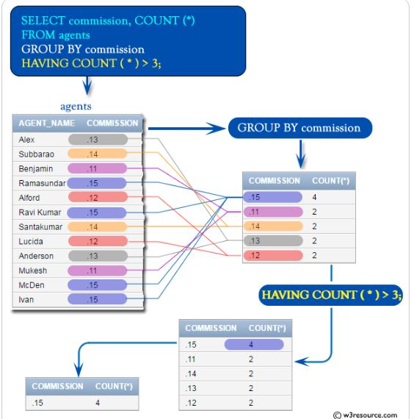

Slide 43
To illustrate the use of both a having clause and a where clause in the same query, we consider the query “For each course section offered in 2009, find the average total credits (tot cred) of all students enrolled in the section, if the section had at least 2 students.”
select course _id, semester, year, sec_id, avg (tot cred)
from takes natural join student
where year = 2009
group by course id, semester, year, sec _id
having count (ID) >= 2;

Slide 44
Null Values and Aggregates
Total all salaries
select sum (salary ) from instructor
Above statement ignores null amounts
All aggregate operations except count(*) ignore tuples with null values on the aggregated attributes
What if collection has only null values?
count returns 0
all other aggregates return null
Notes:
44
COUNT(*) returns the number of rows in a specified table without getting rid of duplicates. It counts each row separately. This includes rows that contain null values.

Slide 45
